Slide 1
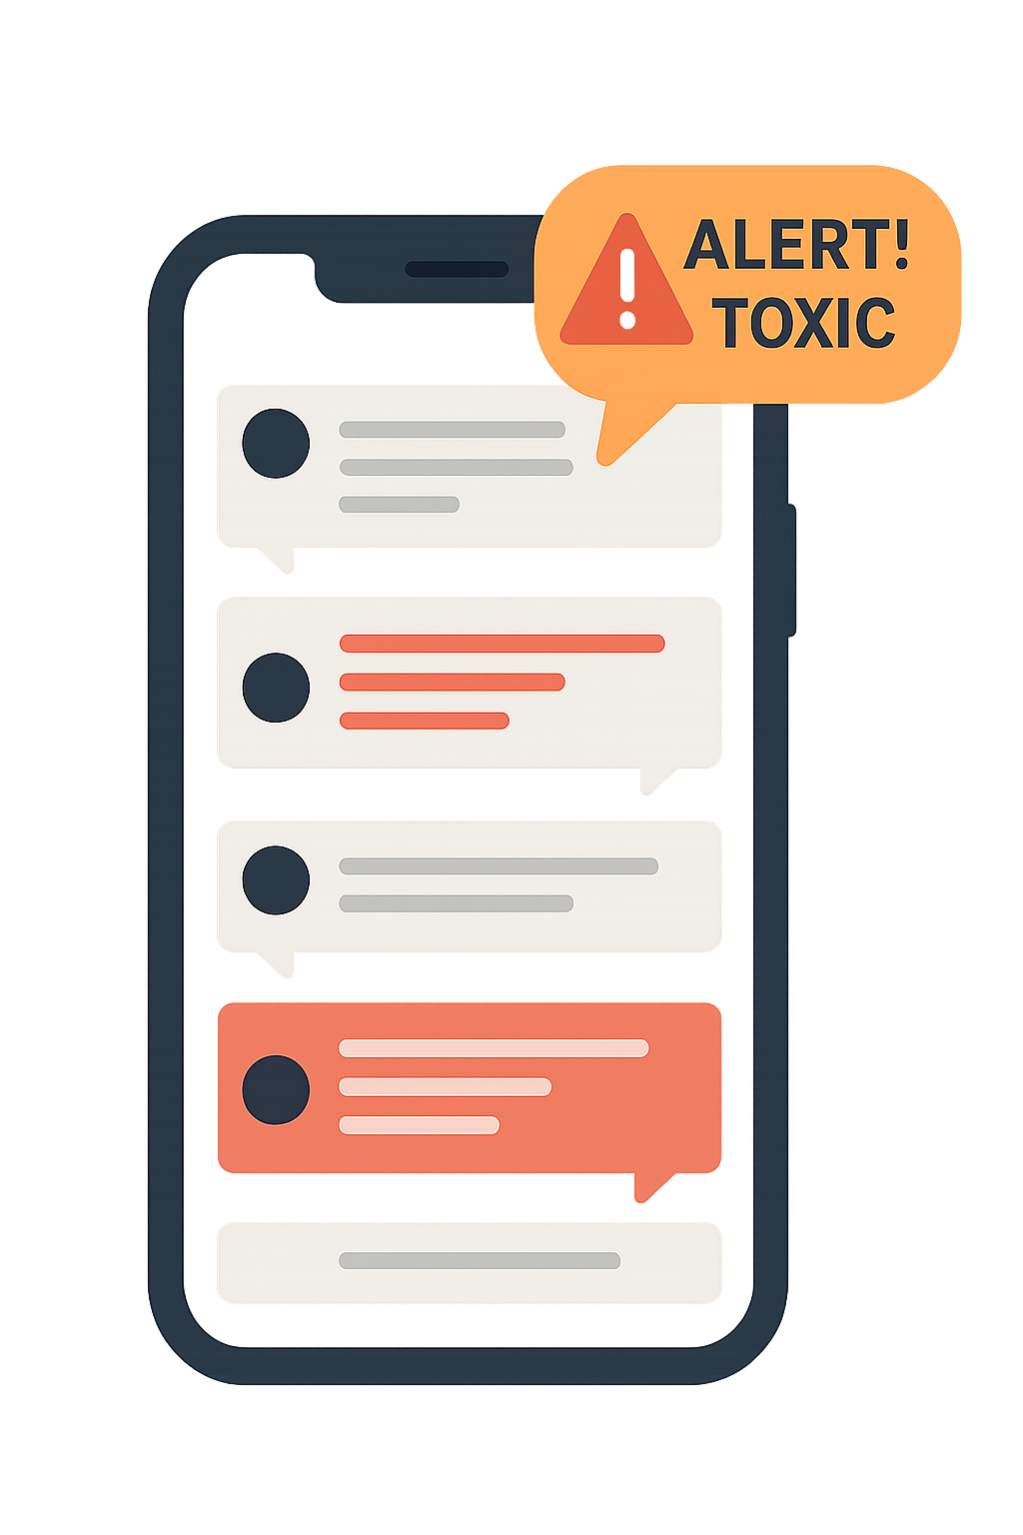
Toxic Language Detection
Ron Butbul
Rotem Mustacchi
Yuval Horesh

Slide 2
Project Description
Motivation: Promote a safer online environment by automatically identifying toxic messages in chat systems.
Task: Classify short chat messages as either Toxic or Non-Toxic.
Challenges: Ambiguity, sarcasm, slang, short messages.
Data: Jigsaw Toxic Comment Classification dataset (Kaggle), over 150,000 labeled comments.
Evaluation: Accuracy, Precision, Recall (focus on Toxic class).

Slide 3
Previous Work
Jigsaw Challenge (Kaggle): Logistic Regression, BERT, class imbalance addressed.
'Toxicity Detection with BERT' (Google Jigsaw): Fine-tuned BERT on conversational datasets.
'Abusive Content Detection' (Davidson et al.): Bias and feature engineering insights.

Slide 4
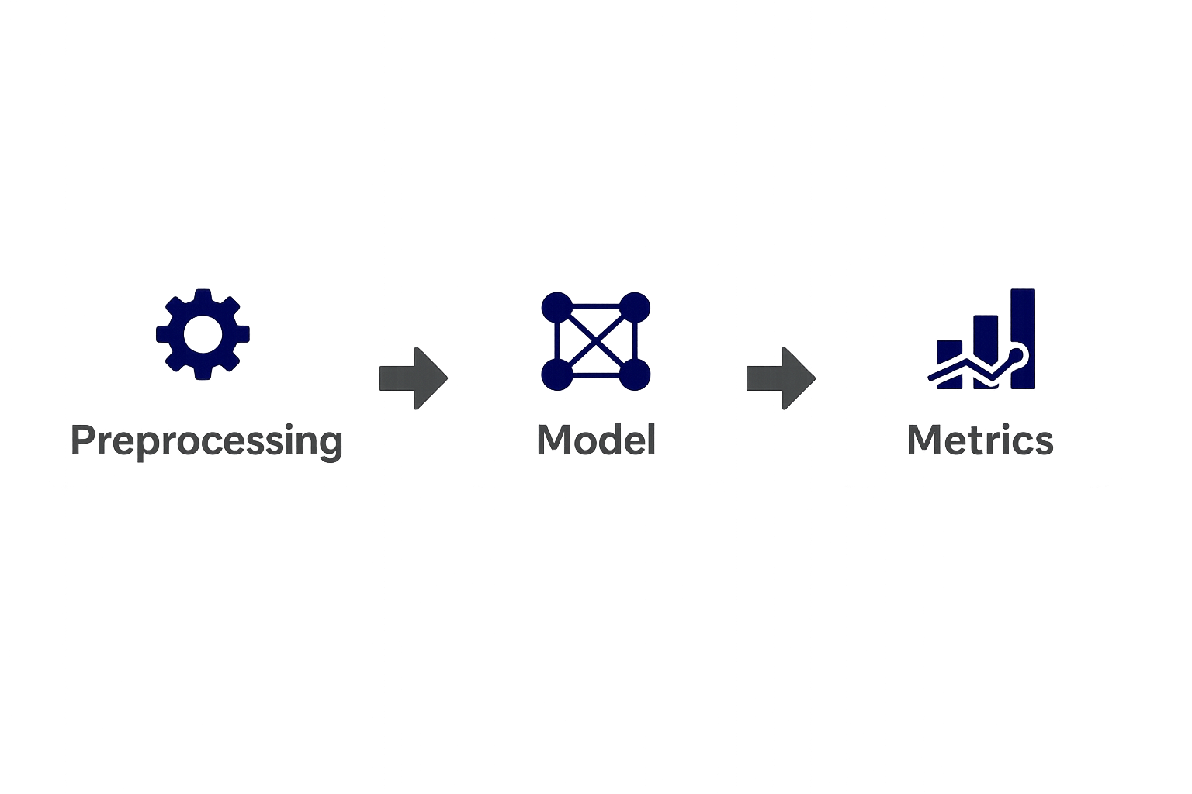
Project Plan – NLP Pipeline
• Preprocessing: Lowercase, punctuation removal, tokenization.
• Models:
– Baseline: Naive Bayes + TF-IDF
– Model 2: Logistic Regression + enhanced features
– Model 3: DistilBERT fine-tuning
• Metrics: Accuracy, Precision/Recall (Toxic), F1-Score

Slide 5
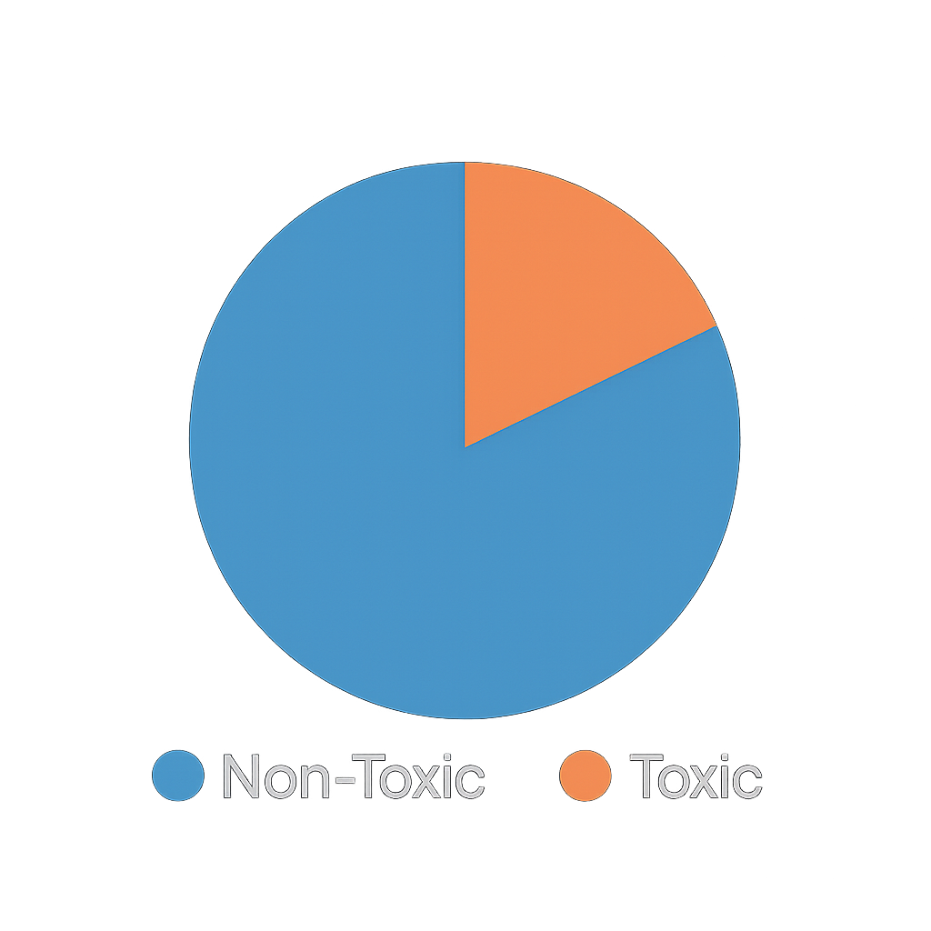
Data Exploration & Baseline
• Class Distribution: Around 90% Non-Toxic, around 10% Toxic (Imbalance).
• Insights: Toxic messages are shorter, contain more extreme words.
• Baseline Model (Naive Bayes):
– Accuracy: 91%
– Precision (Toxic): 65%
– Recall (Toxic): 55%
• Conclusion: Misses many harmful messages.

Slide 6
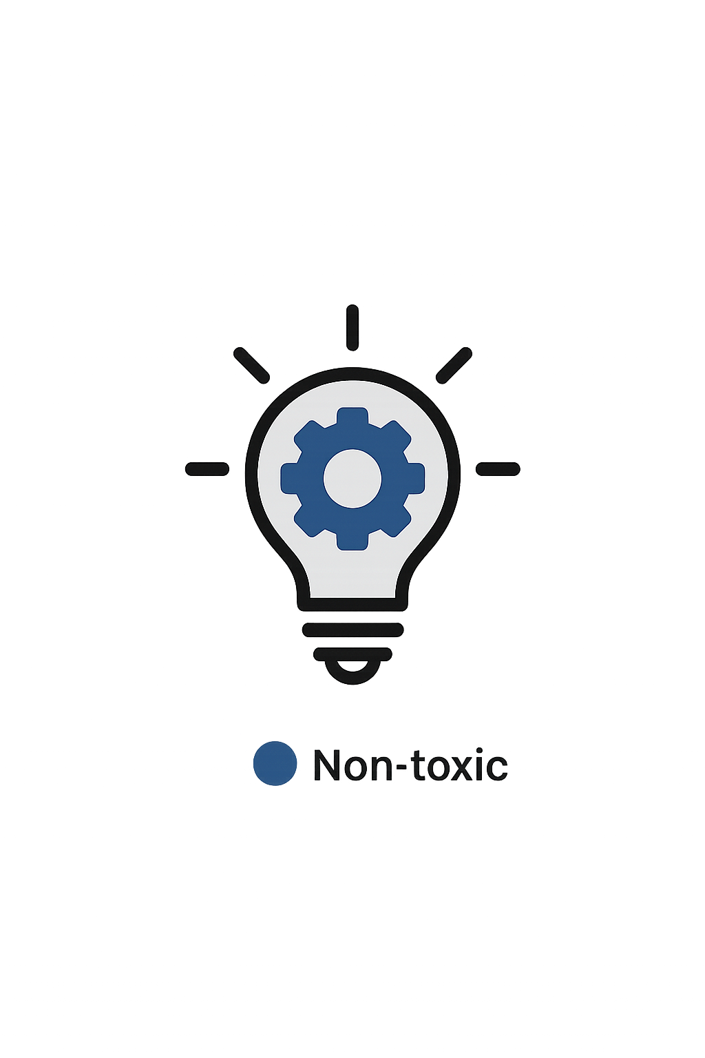
Insights & Next Steps
• Class imbalance needs handling (resampling, weighting).
• Naive Bayes lacks context sensitivity.
• Improve preprocessing: sarcasm/slang handling.
• Fine-tune DistilBERT with toxic-focused evaluation.
• Consider synthetic data generation for augmentation.

